Slide 1



Difficult cases: Hypereosinophilic Disorders
Princess Ogbogu, MD FAAAAI
The Ohio State University
Amy Klion, MD
Eosinophil Pathology Unit
LPD, NIAID, NIH
Notes:
7 Questions

Slide 2
Disclosures
Dr. Ogbogu: Nothing to disclose
Dr. Klion: Nothing to disclose
None of the therapies discussed, with the exception of imatinib, are FDA-approved for the treatment of hypereosinophilic syndrome.

Slide 3
Case 1
36 year old man presents with acute onset vertigo (sensation of room rocking) and chest discomfort
No other neurologic or cardiopulmonary complaints at onset
ER evaluation significant for normal EKG, troponin 0.11, and absolute eosinophil count (AEC) 12,400
Admitted for evaluation of cardiac pre-syncope and hypereosinophilia

Slide 4
Case 1 (continued)
PMH: Bipolar disorder, no asthma or atopy
Family Hx: Remote paternal history of leukemia, no family history of atopy
Social Hx: Freelance writer, 26 pack year hx of smoking (quit 2011), rare alcohol use, denies illicit drugs
Travel Hx: Born in Germany; Lived in rural China (1987); Visited Mexico (2006), Japan (2008, 2009), Thailand (2011)

Slide 5
Case 1 (continued)
Meds: aripiprazole (start date 2006)
Physical Exam: Obese, otherwise unremarkable
Cardiac evaluation:
  EKG: NSR, no ST-T wave changes
  Echo: EF 65%, mild diastolic dysfunction
  Stress Test: No abnormalities
Notes:
Abilify

Slide 6

Question 1
What is the most likely diagnosis?
Churg Strauss Syndrome
Hypereosinophilic Syndrome
Helminth Infection
Coronary artery disease and asymptomatic (benign) eosinophilia
Drug hypersensitivity

Slide 7
Hypereosinophilia and hypereosinophilic syndromes
  Blood eosinophilia ≥ 1500/mm³ on at least two occasions or evidence of prominent tissue eosinophilia associated with symptoms and marked blood eosinophilia
  Exclusion of secondary causes of eosinophilia, such as parasitic or viral infection, allergic diseases, drug- or chemical-induced eosinophilia, hypoadrenalism and neoplasms
  Evidence of end organ damage attributable to eosinophilia
HE
HES
(Klion et al. JACI 2006; Simon et al. JACI 2010)
(Valent et al. JACI 1012)
Notes:
HE = hypereosinophilia; see the Valent paper – most recent criteria

Slide 8
Case 1 (continued)
Bone marrow biopsy: hypercellular with marked eosinophilia, dysplastic eosinophils, no cytogenetic abnormalities or blasts
  JAK2, PDGFRA/PDGFRB FISH negative
Labs:
  Repeat AEC 12, 000
  HIV, anti MPO/PR3 antibodies negative
  IgE 398, ANA borderline positive
Notes:
There should be an AEC with the bone marrow exam. This would document 2 elevated counts. The next thing to do would be to treat with empiric steroids + ivermectin (because of his travel history)

Slide 9
Question 2
What is the next best course of action?
Observe with serial CBCs
Treat empirically with prednisone 1 mg/kg
Treat empirically with prednisone 1 mg/kg + ivermectin
Perform cardiac biopsy

Slide 10
Suspected HES with potentially life-threatening manifestations
Limited diagnostic evaluation
Empiric treatment with high dose steroids (+ ivermectin for Strongyloides if potential exposure)
Yes
No
Response?
Proceed with evaluation
Add second agent

Slide 11
Case 1 - continued
Discharged home with no specific therapy; admission attributed to anxiety and dehydration
Presented 3 months later with chest pressure, troponin peak of 4.36, and EKG with new T wave inversions in anterior leads, and AEC of 11,380
Notes:
I would go on to say that unfortunately that wasn’t what was done – make it clear that this was not us!

Slide 12
Case 1 -continued
CT Chest/Abd/Pelvis : interstitial lung changes, bilateral lung nodules, mediastinal lymphadenopathy, splenomegaly
PFT’s showed restrictive pattern with diffusion defect
Bronchoscopic biopsies- patchy interstitial fibrosis, no evidence of vasculitis, no malignancy

Slide 13
Question 3
Which routine laboratory tests would be most helpful in determining the etiology of the eosinophilia in this patient?
Lymphocyte phenotyping and clonality testing
Serum vitamin B12 and tryptase levels
ACE level
ESR, anti-CCP, RF, repeat ANA and ANCA
D816V KIT testing
Notes:
His lung picture could have been sarcoid or rheumatoid lung

Slide 14
Case 1 - continued
  Flow cytometry: unremarkable T and B cell populations; TCR rearrangement polyclonal pattern
  Serum B12: 1725 (normal 180-914 ng/L)
  Serum tryptase 17.1 (normal <11.5 ng/mL)
Notes:
The parasitic evaluation was useless, so I would skip it.

Slide 15
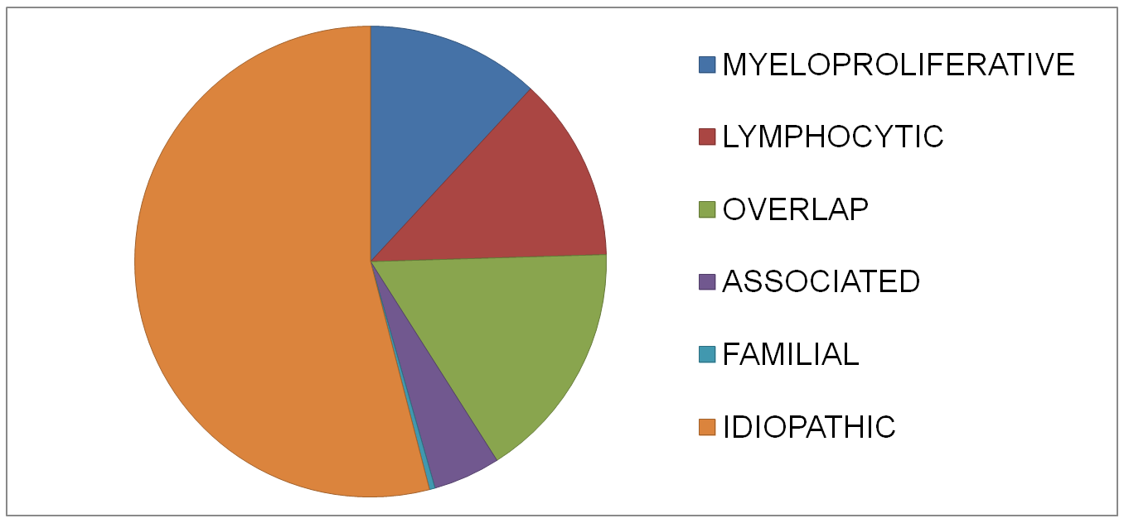
Clinical subtypes of HES
HE_{US}
Single-organ
Involvement
NIH COHORT
(n=263)

Slide 16
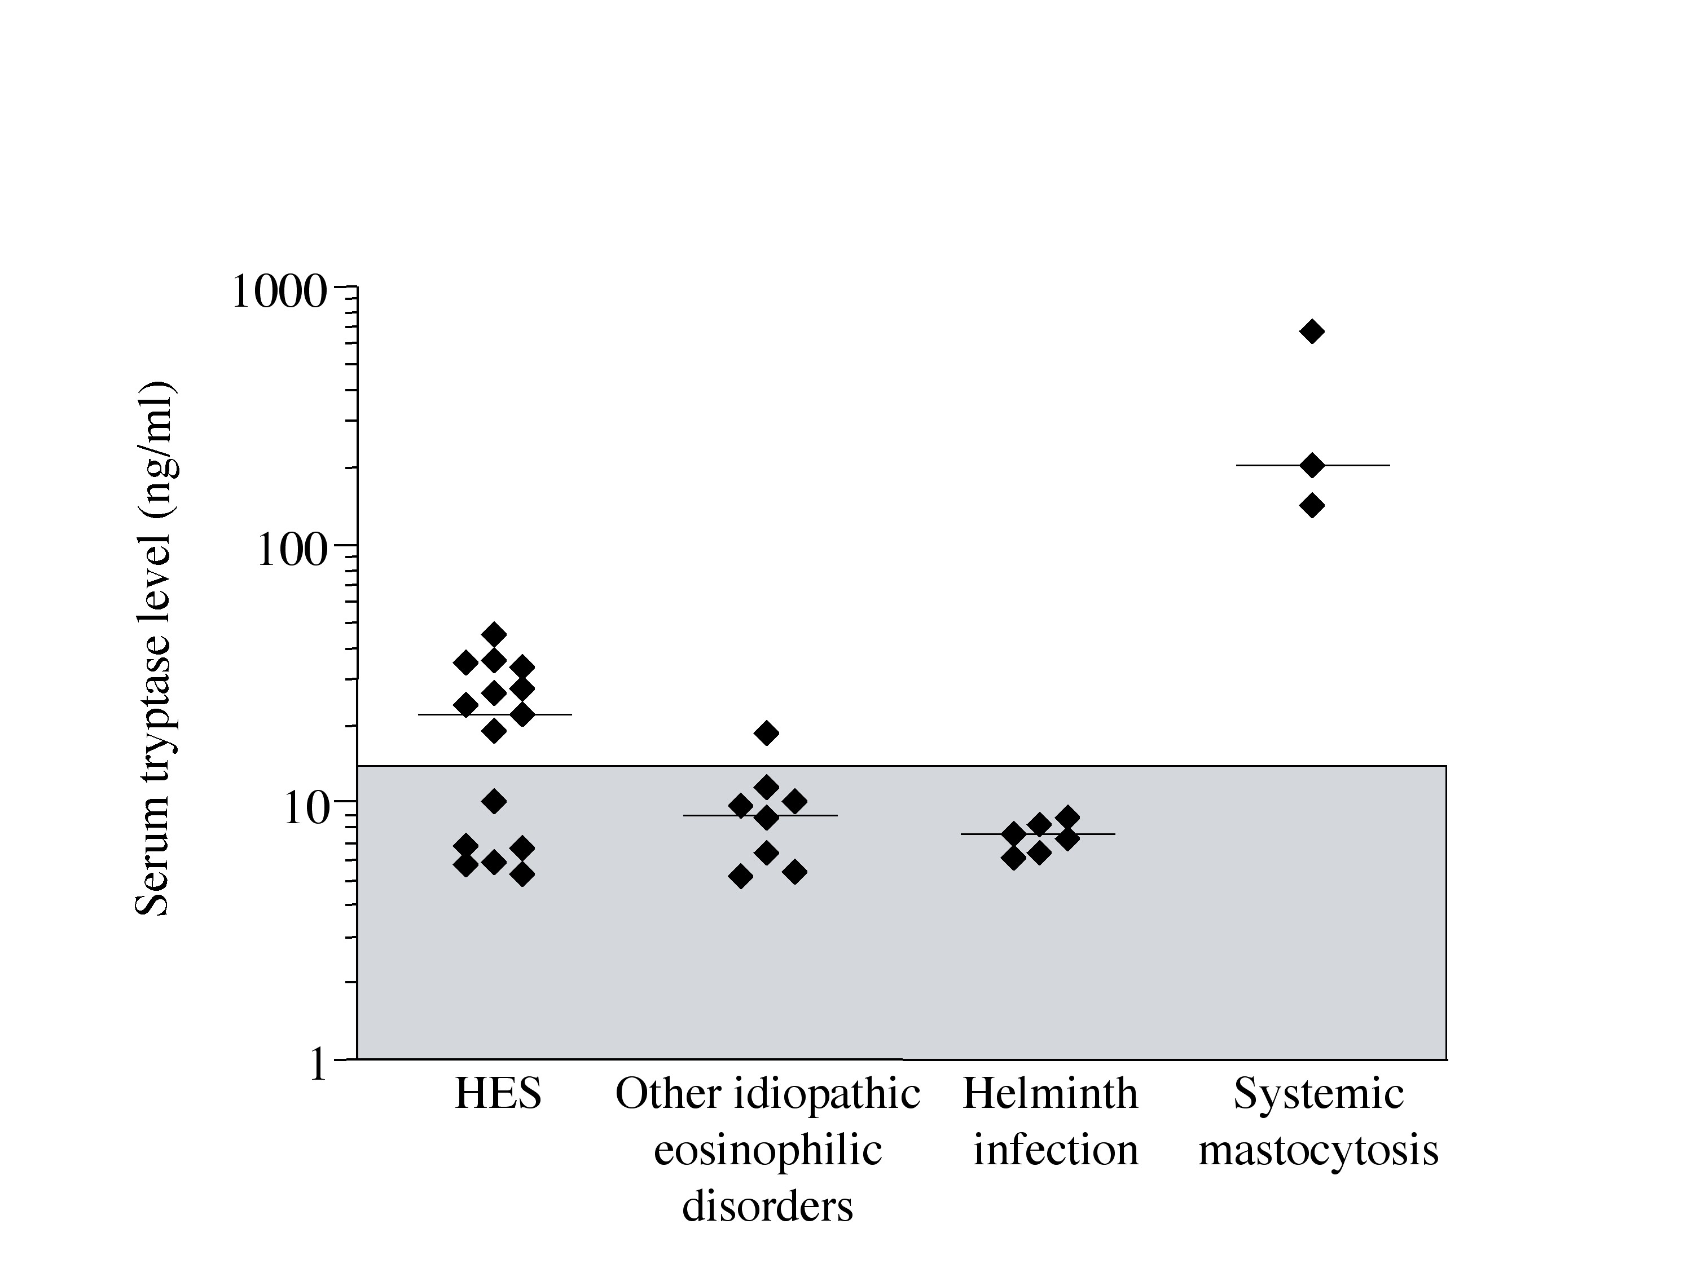
Elevated serum tryptase identifies a myeloproliferative subtype of HES
Male gender
Anemia and/or thrombocytopenia
Dysplastic eosinophils and
myeloid precursors in periphery
Splenomegaly
Hypercellular marrow
Increased serum B12 levels
30% mortality at 3 years
(Klion et al. 2003 Blood)
Notes:
When specifically looking at myeloproliferative subtype…

Slide 17
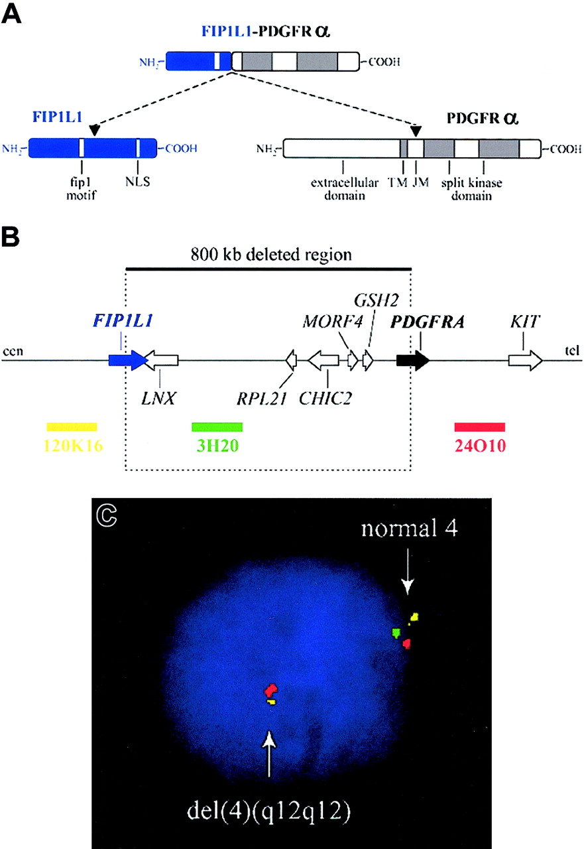
PDGFRA-associated MPN
Caused by an interstitial deletion in chromosome 4 that leads to a constitutively activated fusion tyrosine kinase that is sensitive to imatinib (Cools et al. NEJM 2003)
  Can be detected by nested RT-PCR or FISH
  A number of additional fusion partners, as well as point mutations, have now been identified
(Gotlib 2004 Blood)
Notes:
One of the best characterized forms of MHES (>80% cases), particularly in male patients is caused by an interstitial deletion leading to a constitutively activated fusion tyrosine kinase known as F/P

Slide 18
Initial treatment algorithm
Myeloproliferative features?
Y
N
PDGFRA-positive?
Y
N
Corticosteroid trial
N
Imatinib 100-400 mg daily for 4 weeks*
Criteria met for CEL-NOS?
Varied + typing for BM transplant
Y
*with steroids if cardiac
involvement suspected
Notes:
In terms of treatment with suspected myeloproliferative HES…
Suggestive features of CEL-
2% peripheral blood or >5% BM blasts
Clonal eosinophils
Cytogenetic abnormalities (trisomy 8 most common)
Exclusion of other known mutations
Aggressive, but IFNa successful in few cases

Slide 19
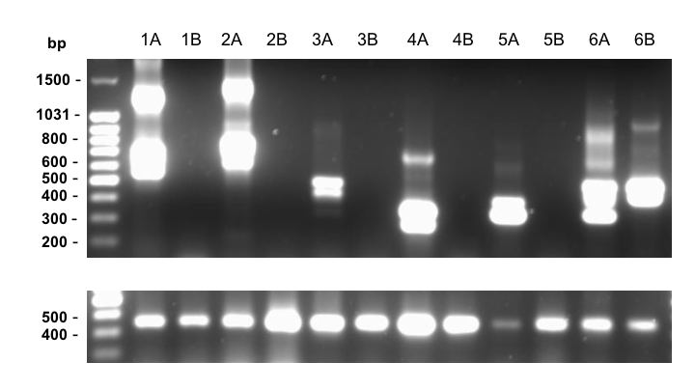
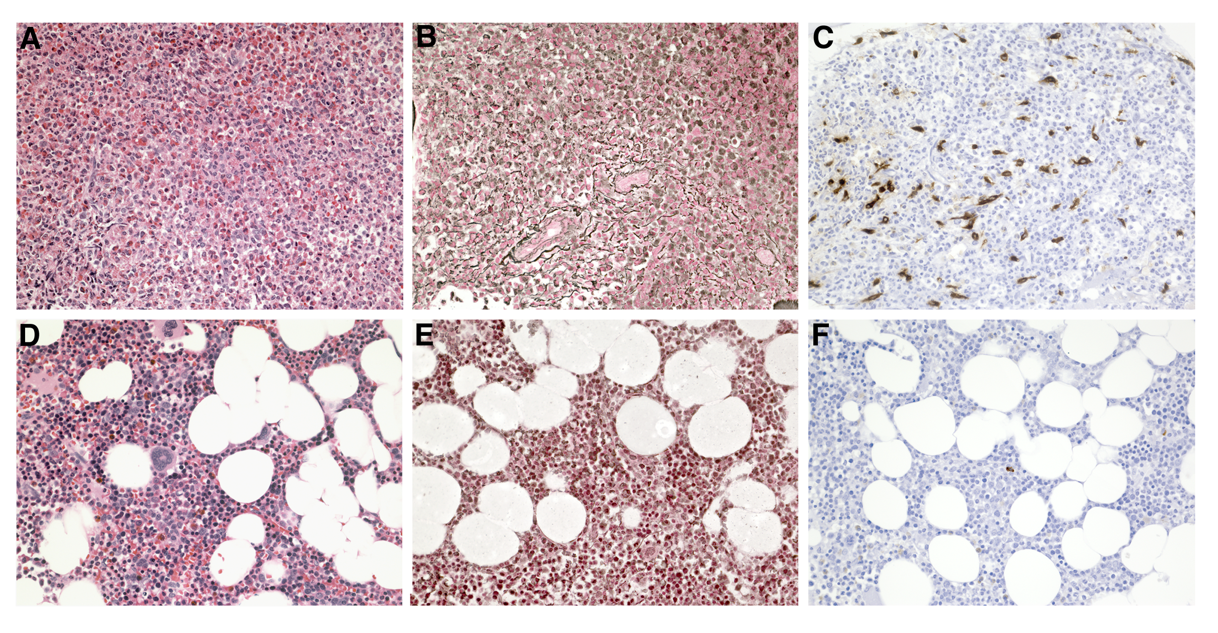
Clinical, molecular and hematologic remission is common, if not universal, in PDGFRA-positive MPN with imatinib treatment at doses of 100-400 mg daily
(Klion et al. Blood 2004)

Slide 20
Case 1 -continued
Patient initially started on high dose steroids (1mg/kg solumedrol)
Repeat FIPL1-PDGFRA mutation analysis at NIH positive
Imatinib 400 mg po daily started
Prednisone tapered
Within 1 week, eosinophil count normalized
After 6 months, the imatinib dose was tapered to 100 mg daily and the patient has been stable for >2 years to date.

Slide 21
Case 1 –Take Home Points
Marked eosinophilia with cardiac involvement requires urgent intervention
No test is perfect
Clinical findings and routine laboratory testing are useful in distinguishing myeloproliferative HES form other causes of marked eosinophilia
Although prednisone is first line therapy for most forms of HES, PDGFRA-positive disease requires imatinib therapy (with concomitant steroids if troponin is elevated)

Slide 22
Case 2
35 year old female presents with fatigue, unintentional weight loss, pruritus, and rashes
Rashes described as eyelid scaling and swelling, and maculopapular eruptions in a dermatomal distribution on body

Slide 23
Case 2- continued
PMH: Gestational diabetes
FH: HTN, DM, no atopy
Social History: married with 3 children, stays at home, prior bio-scientist with major Pharma company
Travel History: 3 trips to India over last 10 years to visit family
Medications: Recently started metformin for elevated blood sugars

Slide 24
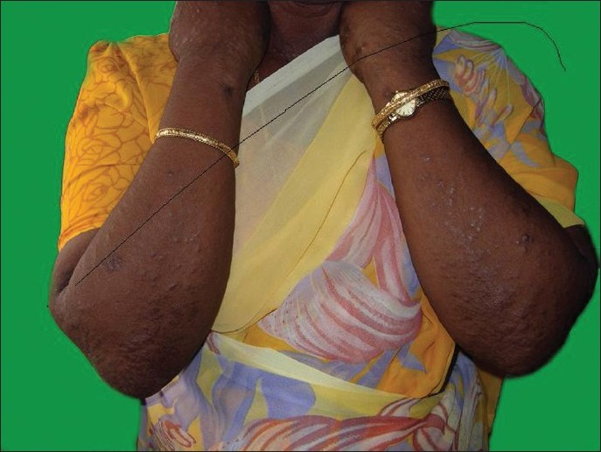
Case 2- continued
PE: Significant for lymphadenopathy in neck, axilla, and inguinal region, as well as diffuse eczematous rash
Labs: AEC 5700
  CBC normal 2 years prior

Slide 25
Question 4
What would be the most common cause of new onset eosinophilia in this patient?
Drug Reaction
Connective Tissue Disease
Parasitic Infection
Atopic Dermatitis

Slide 26
Most common causes of marked eosinophilia
Atopic disease
  Most common cause of mild eosinophilia in US
  Rarely >1500/mm³
Helminth infection
  Most common cause of marked eosinophilia worldwide
  Especially tissue-invasive ( including filariasis which is endemic in India)
Drug hypersensitivity
  Most common cause of marked eosinophilia in US
  Any drug or dietary supplement can be the cause
  Can be asymptomatic

Slide 27
Case 2- continued
Metformin discontinued, and changed to Glipizide
Rash and fatigue continue
Now with increased complaints of painful cervical and inguinal lymphadenopathy
Repeat labs: AEC 12, 200
Referred for workup of eosinophilia

Slide 28
Case 2- Continued Evaluation
Lab testing revealed:
  IgE 11,980
  Serum tryptase 7
  Serum vitamin B12 413
  EBV IgG +/IGM-
  HIV-
CT chest/abd/pelvis remarkable for para-aortic, bilateral inguinal, and cervical adenopathy

Slide 29
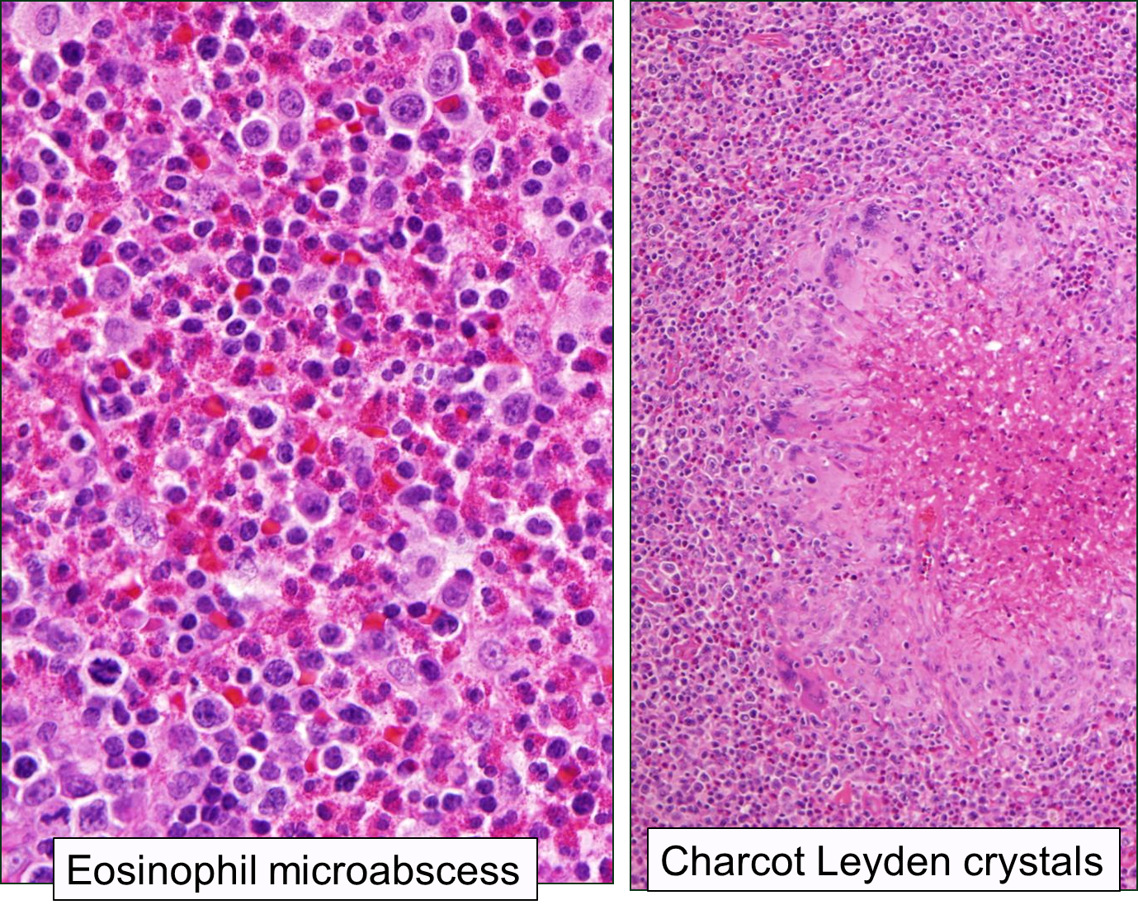
Case 2- Continued Evaluation
Lymph node biopsy showed reactive changes with sheets of eosinophils
Bone marrow biopsy showed no evidence of malignancy

Slide 30
Question 5
What additional information best supports a diagnosis of lymphocytic-variant HES?
Positive FIP1L1-PDGFRA mutation by FISH
Elevated serum vitamin B12 and tryptase
Clonal TCR rearrangement
Normal lymphocyte populations on flow cytometry

Slide 31
Clinical subtypes of HES
HE_{US}
Single-organ
Involvement
NIH COHORT
(n=263)
Notes:
I am repeating this slide for reinforcement and to discuss LHES

Slide 32
Lymphocytic variant HES
Associated with populations of phenotypically aberrant or clonal T cells secreting eosinophilopoetic cytokines
Equally common in men and women
Predominance of skin manifestations
Often associated with elevated serum IgE, TARC (CCL17) levels
Diagnosed by demonstrating abnormal populations of lymphocytes on immunophenotyping or clonal TCR
  Commonly CD3-CD4+, CD3+CD4-CD8-

Slide 33
Production of IL-4 and IL-5, and not IFN-γ, by CD3-CD4+ T cells in LHES
76%
7.9%
0.8%
CD4
IL-4
IL-5
IFNγ
6%
0.8%
13%
CD3

Slide 34
Case 2- continued
Patient referred to NIH for evaluation
AEC on presentation to NIH 70,000; B12 and tryptase normal
Peripheral blood T and B cell receptor rearrangement polyclonal
Flow cytometry notable only slight increase in gamma-delta CD3+CD4- cells

Slide 35
Question 6
What is the first line treatment for non-myeloproliferative HES?
Imatinib
Prednisone
Hydroxyurea
Mepolizumab
Notes:
Discuss treating for Strongyloides prior to steroids if history of potential exposure

Slide 36
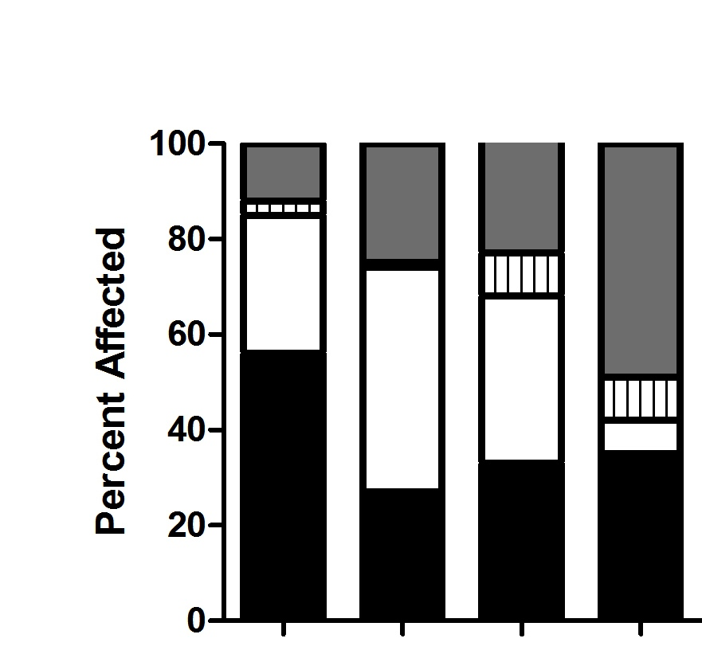
Conventional therapy for HES
Response at 1 month
Prednisone
Hydroxyurea
Interferon-α
Imatinib (FDA-approved for HES in 2006)
P HU IFN IMAT
(Ogbogu et al 2009 JACI)

Slide 37
Case 2- continued
Therapies tried and failed:
  Prednisone up to 60 mg daily
  Interferon Alpha 2 mU daily
  Imatinib 400 mg daily
  Hydroxyurea 1.5 grams daily
  Mepolizumab 750 mg monthly

Slide 38
Question 7
What is a long-term risk in patients with L-HES?
Cardiomyopathy
Lymphoma
Stroke
Pulmonary Fibrosis
All of the above
Notes:
May progress to lymphoma <3%; usually preceded by cytogenetic abnormalities and lymphocytosis

Slide 39
Case 2- Clinical course
Increased SUV’s on PET prompted axillary lymph node biopsy
Flow cytometry confirmed presence of an atypical T cell population not seen in peripheral blood and clonal TCR
Diagnosis of peripheral T cell lymphoma made
Notes:
SUV’s(standardized uptake values)-PET scan repeated due to increasing lymphadenopathy and fatigue

Slide 40
Case 2- Follow up
Patient treated with anti-CD30 monoclonal antibody which induced remission
Recently underwent bone marrow transplant and is clinically doing well with no eosinophilia

Slide 41
Case 2- Take Home Points
Lymphocytic HES is defined by the presence of abnormal T cell populations on flow or TCR that secrete Th2 cytokines, including IL-5
Corticosteroids are first line treatment for non-myeloproliferative HES, including LHES
Increased risk of development of T cell lymphoma in LHES
Lack of response to multiple HES therapies should prompt investigation for underlying malignancy or other secondary cause

